Slide 1
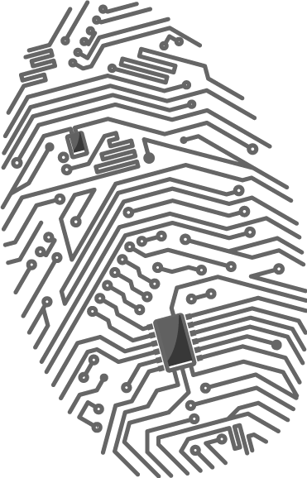
Browser Fingerprinting
CorkSec, 2017-05-09
Johannes Ahlmann
Image: http://bit.ly/2zn96Bx

Slide 2

About Me
Johannes Ahlmann
Recently started Fluquid Ltd.
Machine Learning (NLP, DL, etc.)
Information Extraction
Gathering and Enriching Web Data
Slides + Code
Github: fluquid/browser_fingerprint
Contact: johannes@fluquid.com
fluquid

Slide 3

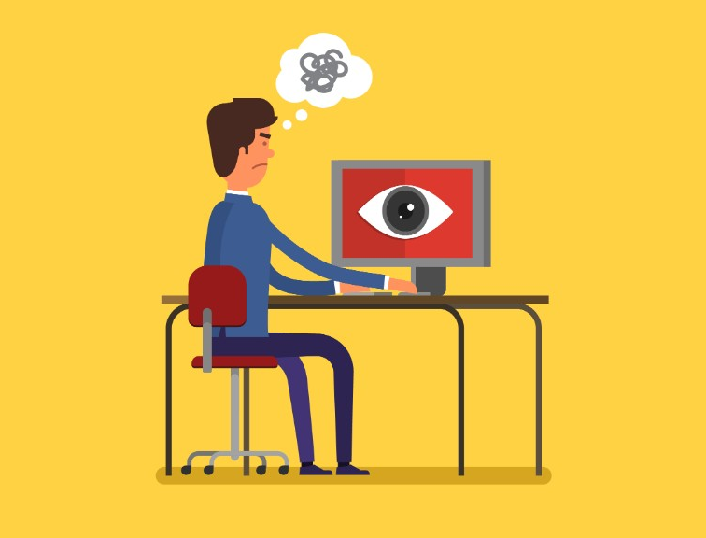
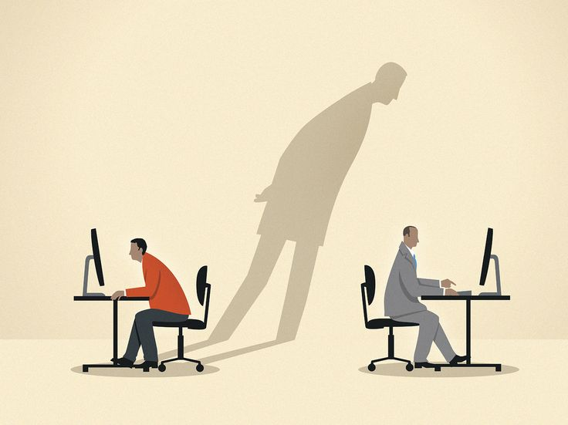

Relevance
Privacy
shadow profiles
cross browser tracking
persistent tracking
Security
journalism sources
dissidents
incognito de-anonimization
De-automation
anti-fraud
anti-bot
Images:
https://weechookeong.files.wordpress.com/2013/07/spying-on-computer.jpg?h=379&w=500
http://i2.cdn.turner.com/money/dam/assets/170329111154-internet-privacy-outrage-1024x576.jpg
https://media.npr.org/assets/img/2016/09/26/gettyimages-173291681-c39025b4d516aa3ccb850e830efcce1527cb1d57.jpg?s=300
http://images.techhive.com/images/idge/imported/imageapi/2014/08/20/15/slide_scrape-100386264-orig.jpg

Slide 4
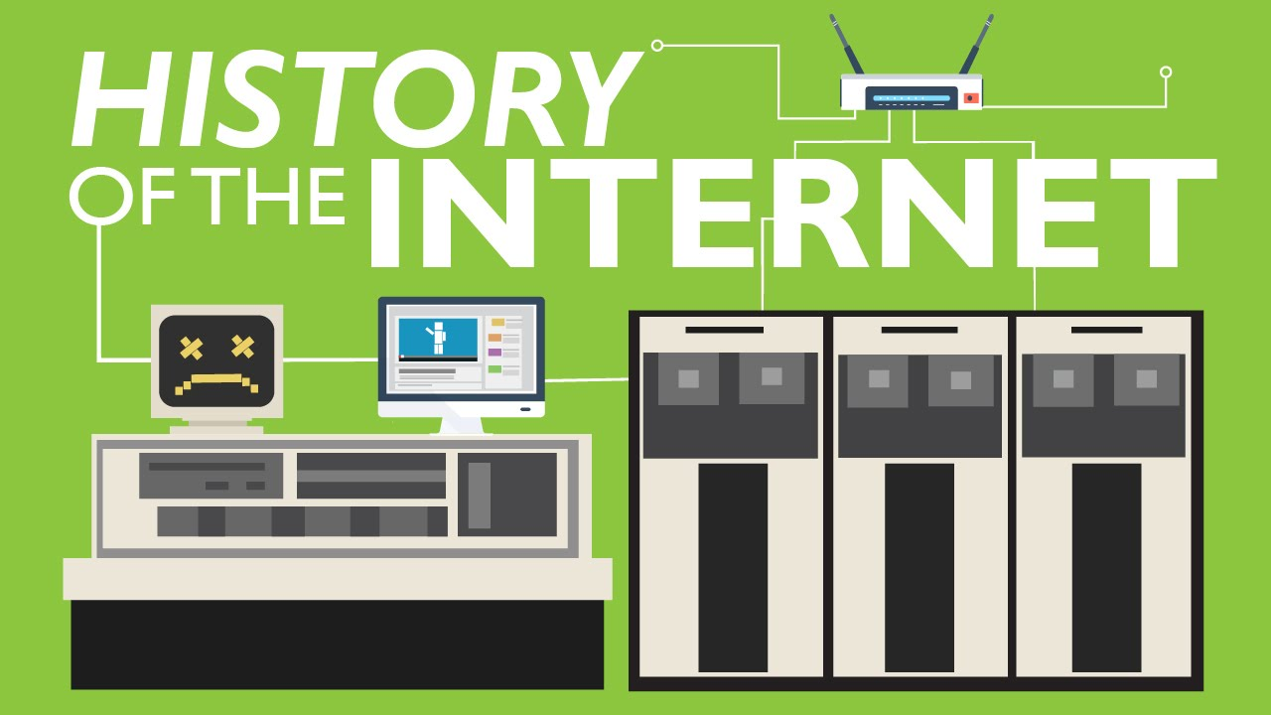
History
Has been around forever, but given limited attention
Particular interest by EFF and in academia since around 2009
2010 – EFF releases panopticlick
Focus often on high-tech aspects
TCP stack
CPU fingerprint
GPU fingerprint
Obviously “fingerprinting” is used in addition to classic techniques (IP, cookies, LocalStorage, etc.)
Image: https://img.youtube.com/vi/h8K49dD52WA/mqdefault.jpg

Slide 5
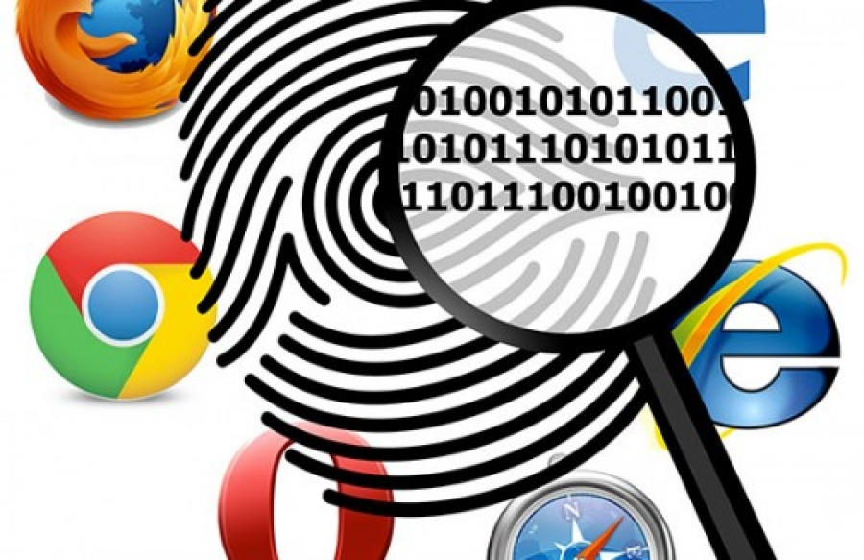
Aspects
Vanilla browser, plugins, battery
Canvas, WebGL
Audio Stack
WebRTC
Countermeasures
Image: https://www.airsassociation.org/media/k2/items/cache/3b31c9fc44003dace54e8f637805f850_XL.jpg

Slide 6
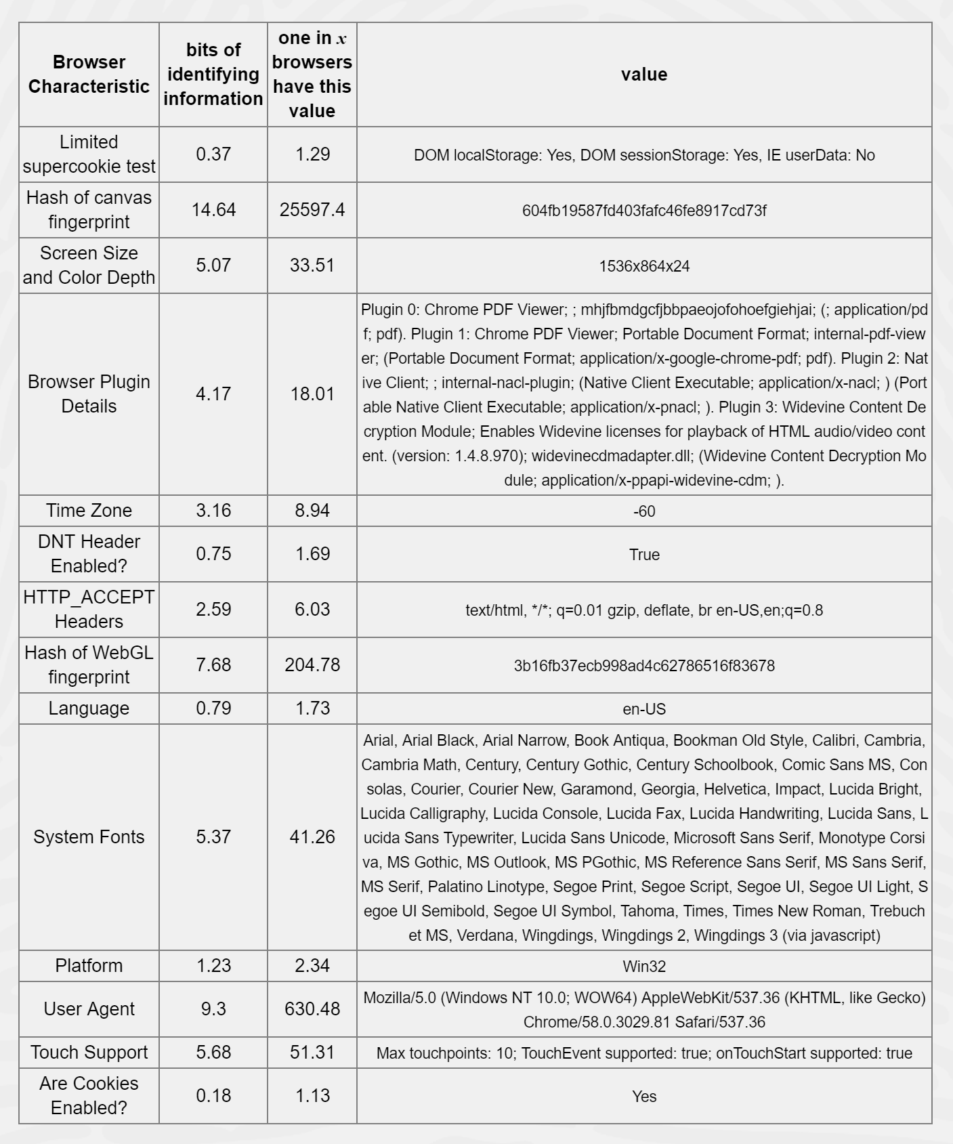
1. Vanilla Browser
User agent
Fonts, font metrics
Plugins
Mime-types
Languages
Screen, colors, touch
CPU, cores, OS, timezone

Slide 7
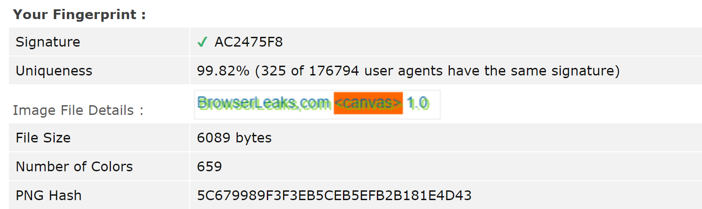
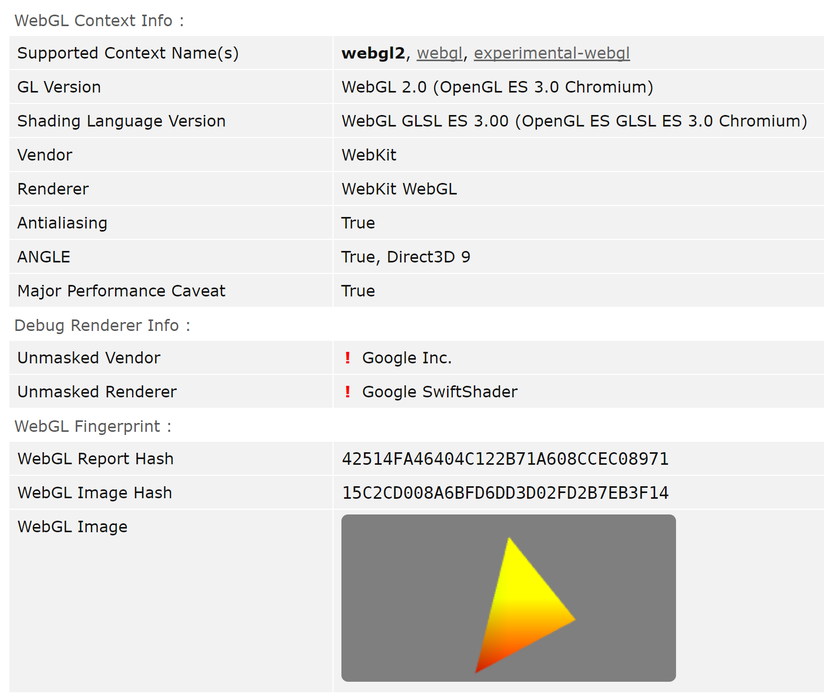
2. Canvas, WebGL
Canvas Fonts
Renders information using
2D Canvas
3D WebGL
Each hardware/system will render information slightly differently
In principle works across browsers, operating systems
Possibly quite difficult to fake well

Slide 8
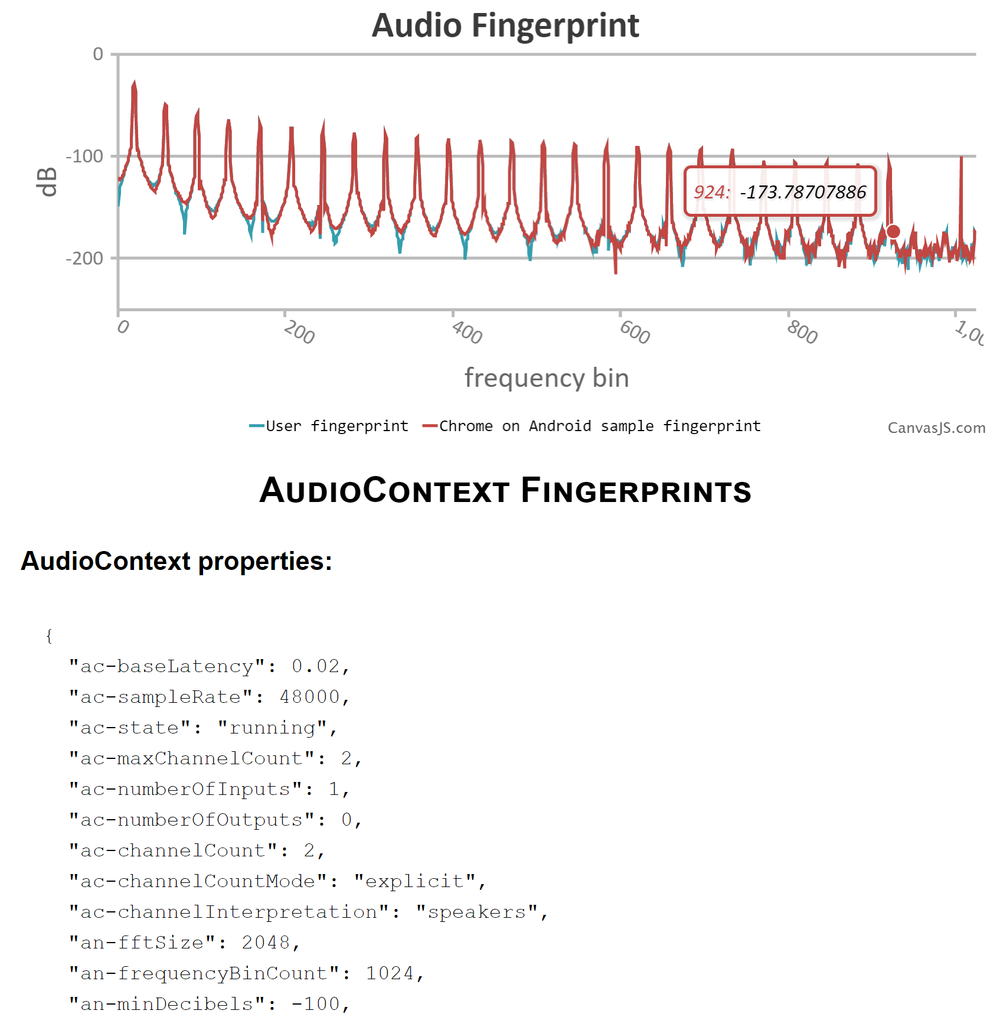
3. Audio Stack
Does not record/play audio
Captures oscillation/compression properties of your machine's audio stack itself
OscillatorNode -> DynamicsCompressorNode -> OfflineAudioContext

Slide 9
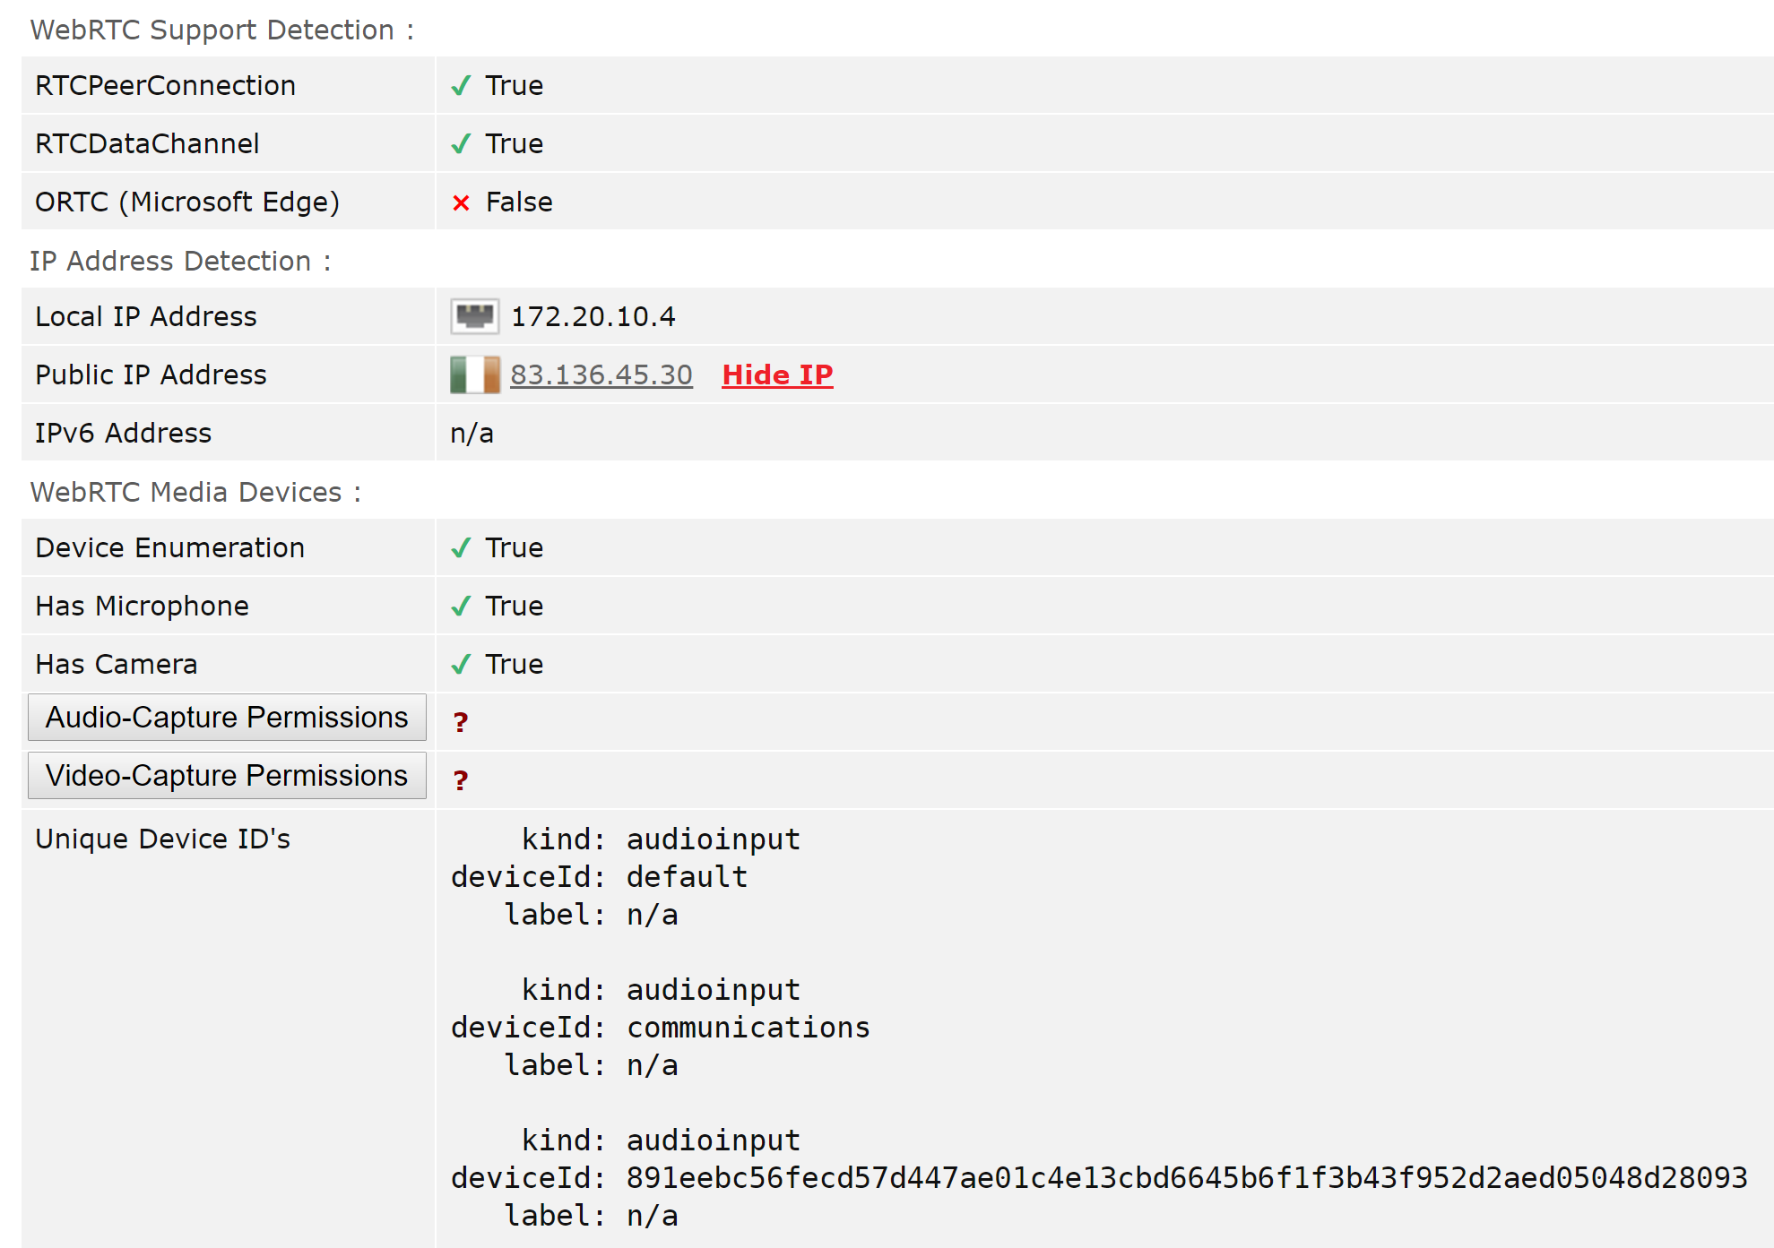
4. WebRTC
Can leak local IP address
Input/Output Device Enumeration (At least hashes are self-generated)
“collects all available candidate addresses, including on local interfaces and makes them available to the web application without explicit permission from the user.” (source)

Slide 10
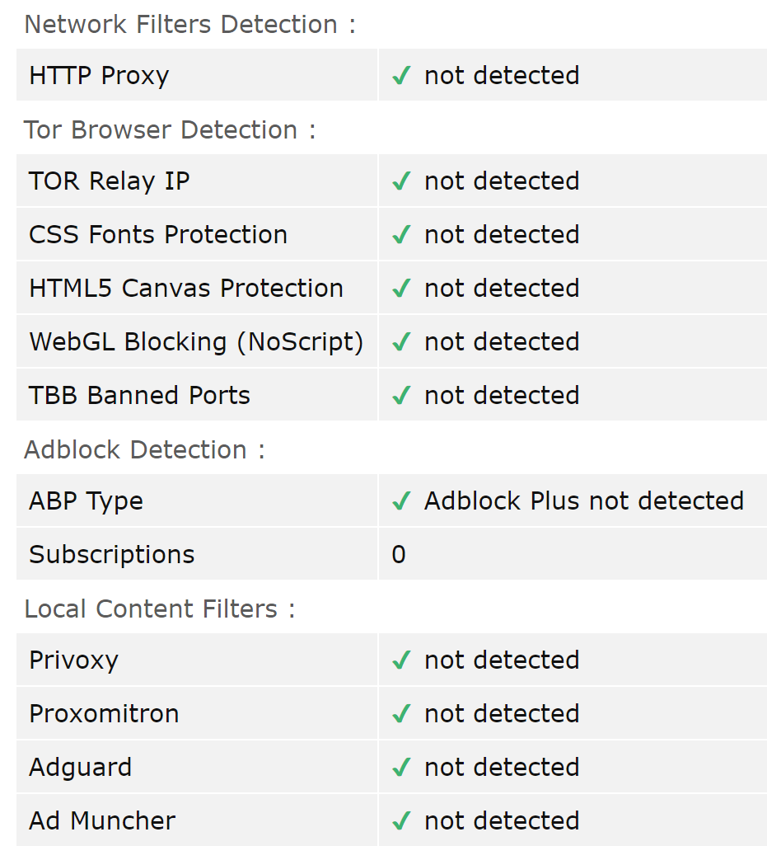
4. Countermeasures
Proper Counter-Intelligence
Act of blocking, protecting, faking responses can lead to track-ability itself
If you are the only person using a particular technique/solution that’s a 100% detection rate ;)

Slide 11
Solutions
No real end-to-end solution
Don’t stick out!
You can’t not communicate
Use as common a setup as possible
If you fake a profile, fake it consistently and choose a low-tech target
Privacy browsers
Epic
Brave
Comodo Dragon/Ice Dragon
Tor Browser
Privoxy
Browser Plugins
Privacy Badger
Disconnect
uBlock
uMatrix
Ideally we’d want to instrument JS engine to intercept calls (electron, nw.js)
Hopefully fingerprinting is brittle, so that small perturbations cause false negatives

Slide 12
Resources
Online
browserleaks.com
amiunique.org
panopticlick.eff.org
uniquemachine.org
browserspy.dk
The web never forgets
OpenWPM Tracking Study
Intro to NAT/Firewall problem
Princeton Web Census
Show me the Code
https://github.com/Valve/fingerprintjs2
https://github.com/jackspirou/clientjs
https://github.com/RobinLinus/ubercookie
https://github.com/qqTYXn7/browserprint
https://github.com/ghostwords/chameleon
https://github.com/AlexanderSelzer/BeaverBird
https://github.com/dillbyrne/random-agent-spoofer
https://github.com/efforg/panopticlick-python
https://github.com/Song-Li/cross_browser
https://github.com/citp/TheWebNeverForgets

